Slide 1
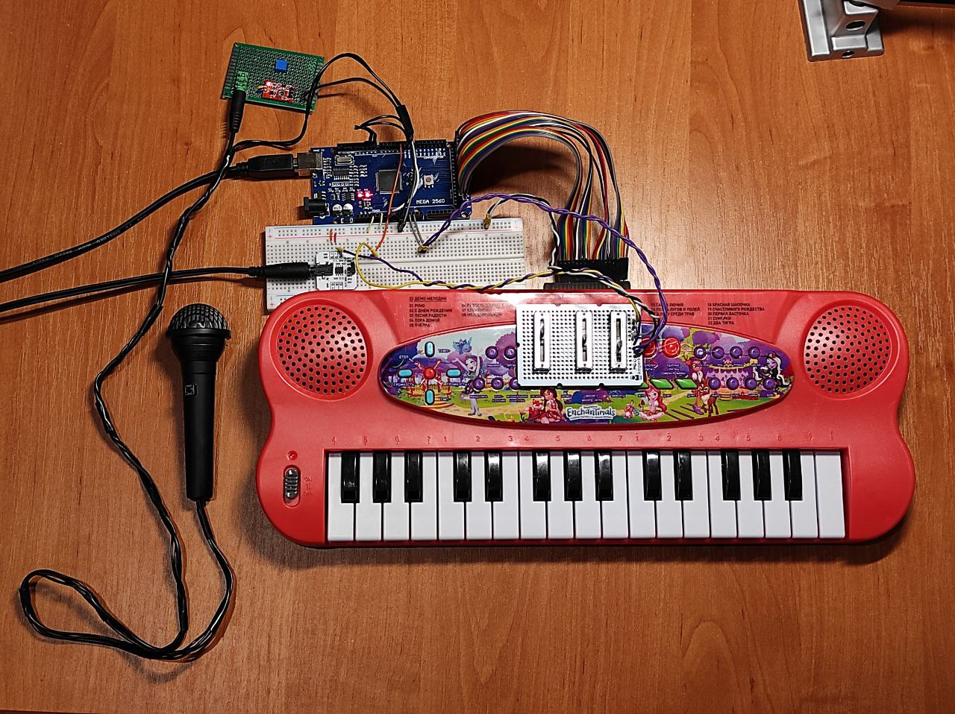
Assembly Instructions for EndlessSynth v.04 DIY Synthesizer version 04_SineSynthArpegiatorMega_Sliders_Boombox
13 Feb. 2021
Project info: https://github.com/EndlessBits/EndlessSynth
Project is created by Endless Attractions museum https://eamusem.com

Slide 2
5. Mic module
ASSEMBLY STEPS
1. Arduino Mega
2. Sound out
4. Sliders
6. Mic with button
3. Keyboard
and 7. Overall view

Slide 3
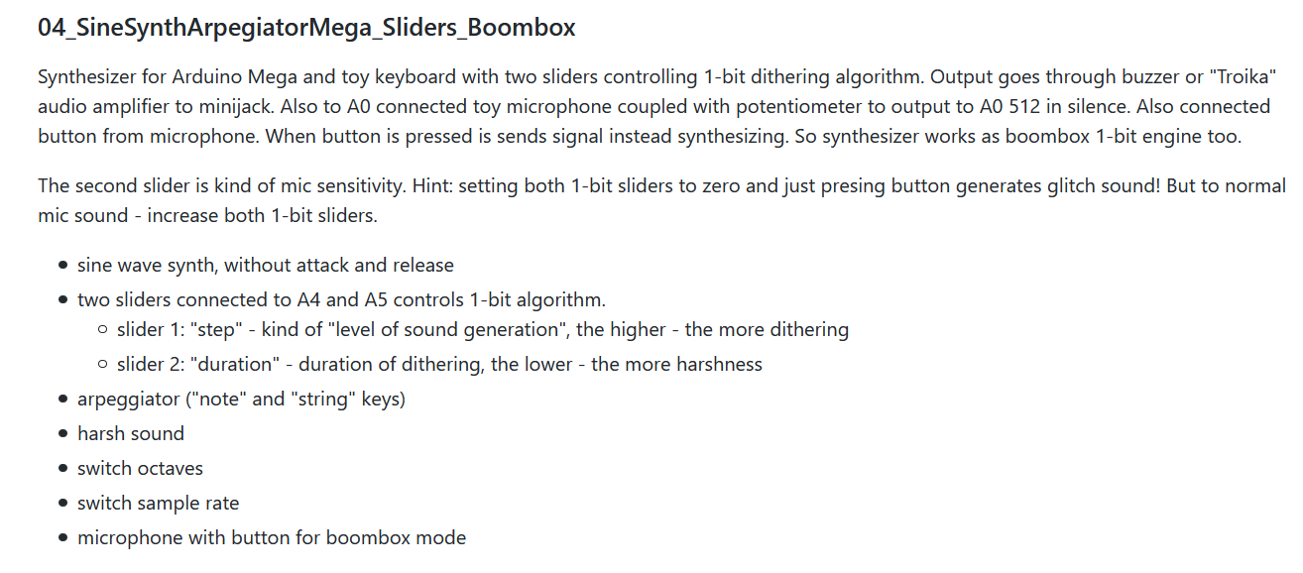
The EndlessSynth v.04 is a 1-bit DIY synthesizer intended to sound experimenting free of obligations
to create “pure” sound. Instead, it’s based on two ideas: use “1-bit sound” and “creat it as simple as possible“.
As a result, the resulted synthesizer is made using very simple components, have short and clean code
and generate harsh 1-bit “old-game sounds”.
This list of features is part of README file at https://github.com/EndlessBits/EndlessSynth/tree/main/synths

Slide 4
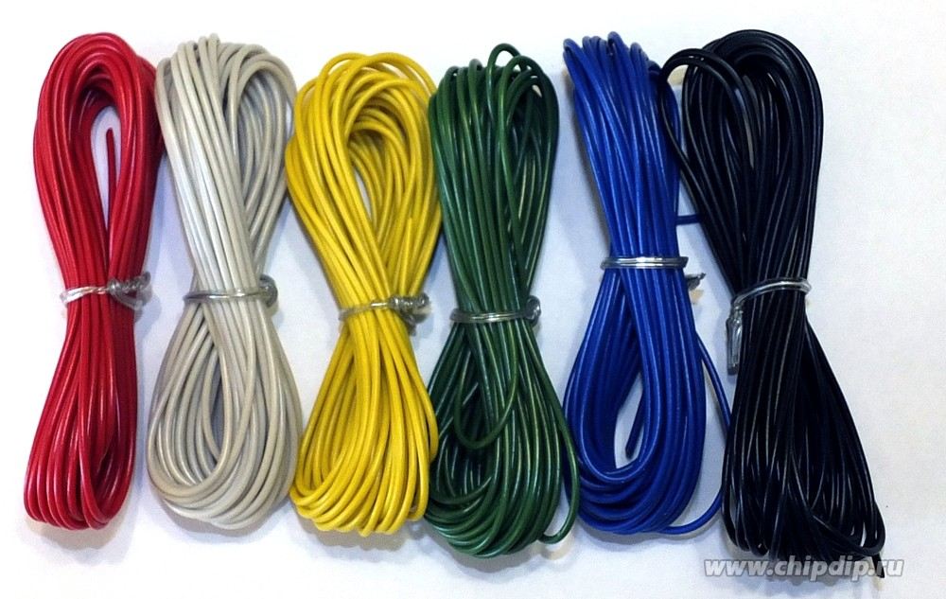
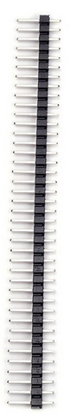

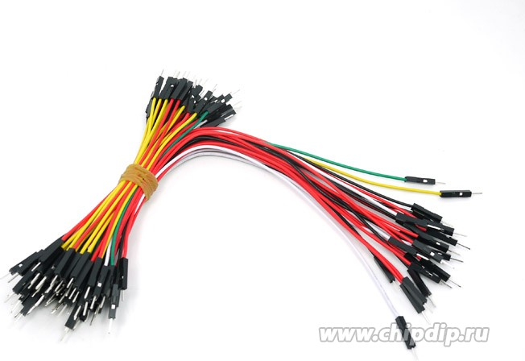
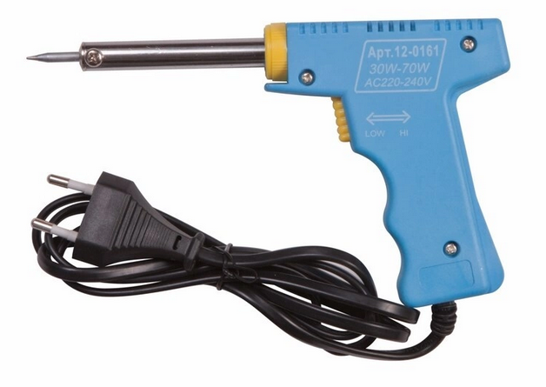
Before you start
At each stage we list required components.
Additionally, you will need - hooking wires, - male pin connectors (need about 50), - heat shrink, - wires with plugs for arduino, - soldering iron and accessories.

Slide 5
1. Arduino Mega
You need: 1) PC
2) Arduino Mega with USB cable
Steps:
Install Arduino IDE to PC
Download code https://github.com/EndlessBits/EndlessSynth/tree/main/synths/04_SineSynthArpegiatorMega_Sliders_Boombox
Please see comments in main sketch file with information which libraries you need to install.
Upload code to Mega.
Try to compile and upload – that’s all we need to now. Nothing will work yet, we just test all is compiling. Later we will test parts of the synthesizer by running test sketches.

Slide 6
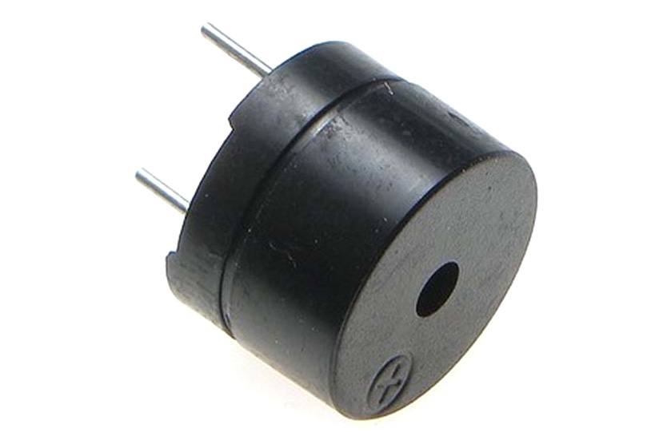
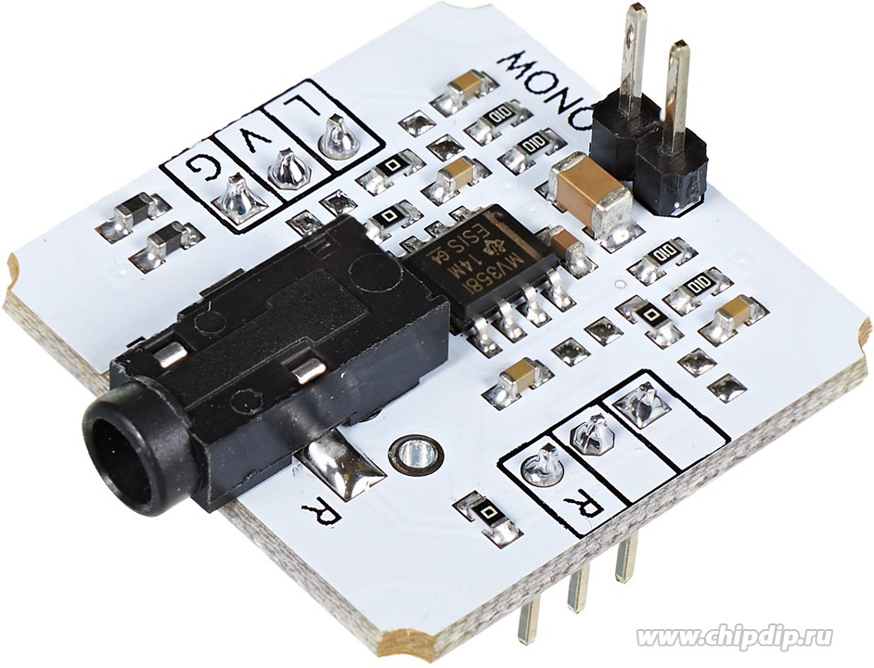
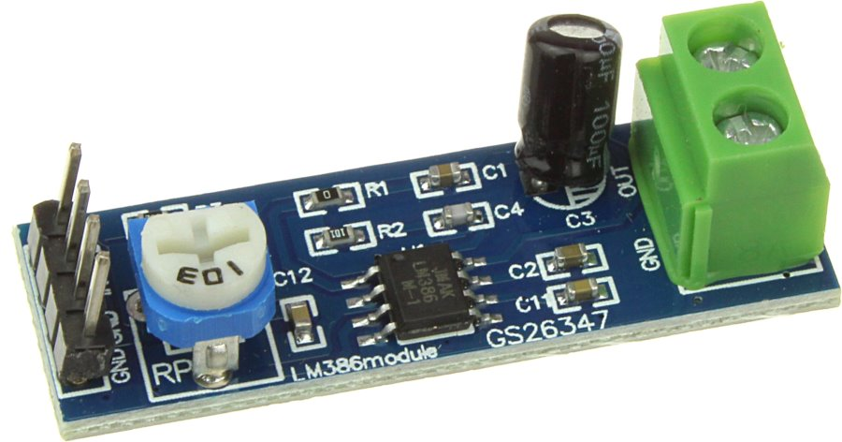
2. Sound out
To output sound from synth you need to choose from three possibilities, depending on synth usage: - Buzzer is “must have” for simple immediate testing. - Out Mini jack is required for performances and sound recording. - Compact amplifier and speaker allows to create ready-to-use synth in one case. Now more details about it:
Simplest: use buzzer You need passive buzzer, 5V. Also, choose biggest one to get better sound.
Pro: Use Troyka-Line Out Mini Jack or similar module with mini-jack output to connect it to your audio amplifiers or speakers.
Note: I have some problems with unwanted sound distortions from here into mixer,
though speakers and sound card process this normally.
Middle: Use compact amplifier and speaker (need amplifier, speaker, power supply).

Slide 7
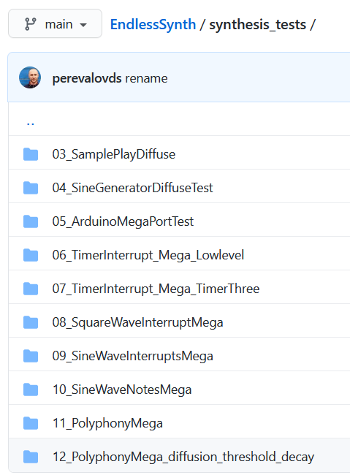
So, choosing and connecting some sound output,
you may explore 1-bit sound synthesis!
For that check the codes:
https://github.com/EndlessBits/EndlessSynth/tree/main/synthesis_tests
This small projects starts from very simple approach
and goes to polyphonic sine wave synthesis using dithering,
Implemented on Arduio timer interrupts.
You may just run it to check the sound,
or explore and learn if you are programmer.

Slide 8
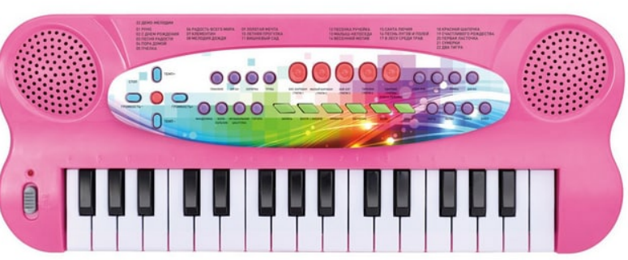
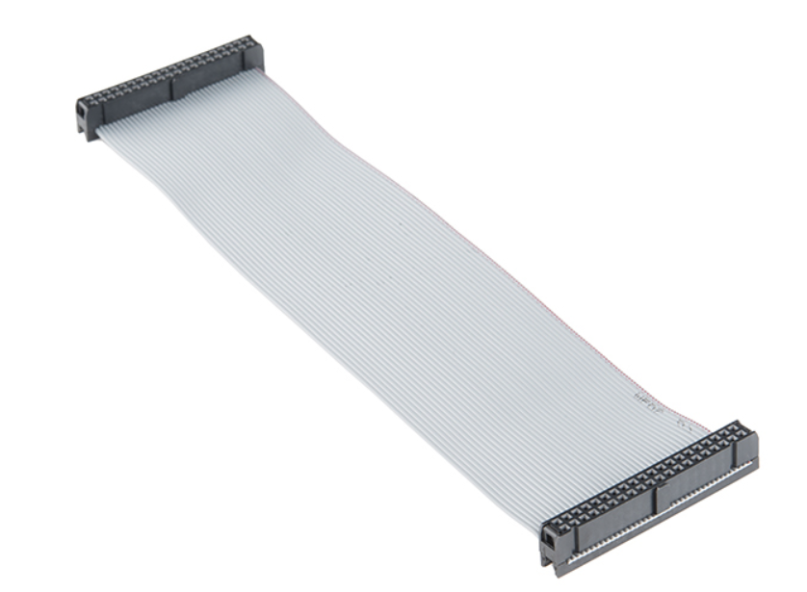
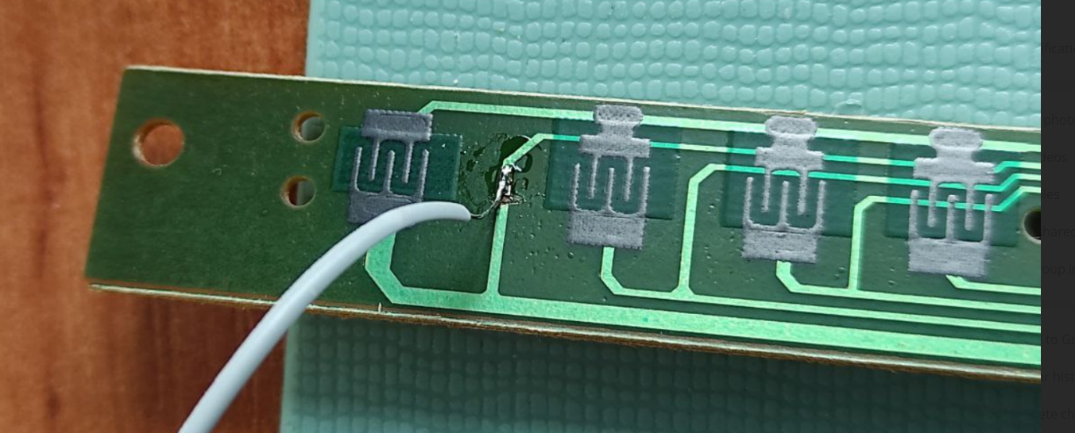
2. Keyboard
You need: 1) Cheap toy keyboard piano with 32 keys.
2) Ribbon cable with 40 pins “Raspberry Pi GPIO Ribbon Cable - 40-pin, 6" (RPi 3, RPi2, B+)”
Steps:
Disassembly toy keyboard
Explore the keyboard’s sensor structure. Cheap keyboards use 4 blocks by 8 keys, in each block only one key may be requested properly. We need “truth” polyphony, so we need to solder tiny wires and break some wires on the sensor.

Slide 9
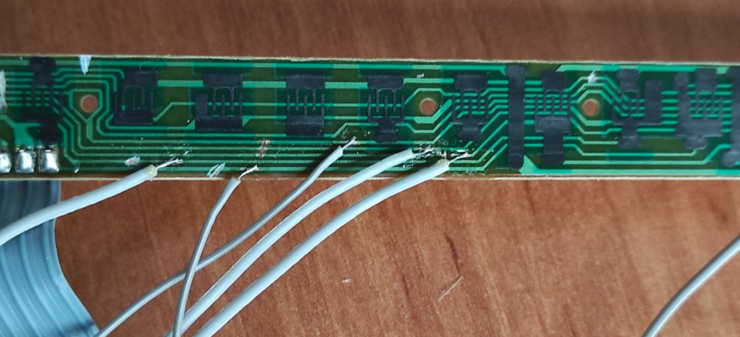
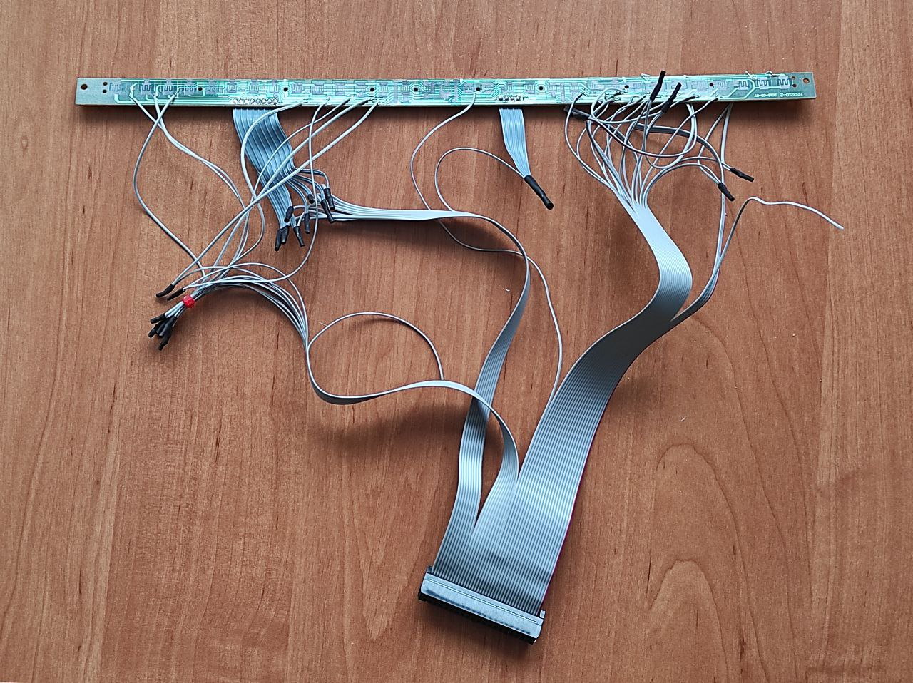
Normally we can use 8 keys from “original” keyboard scheme, and add 24 keys by soldering.
Broke some wires
Solder new wires

Slide 10
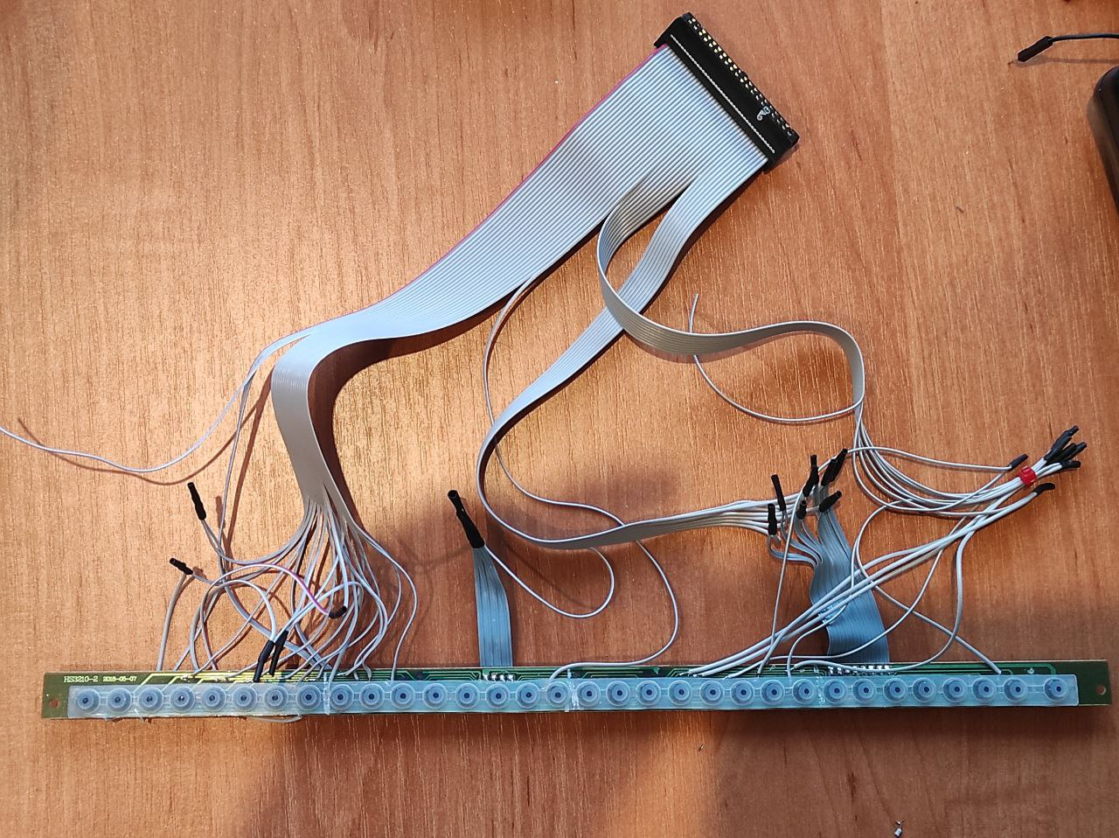
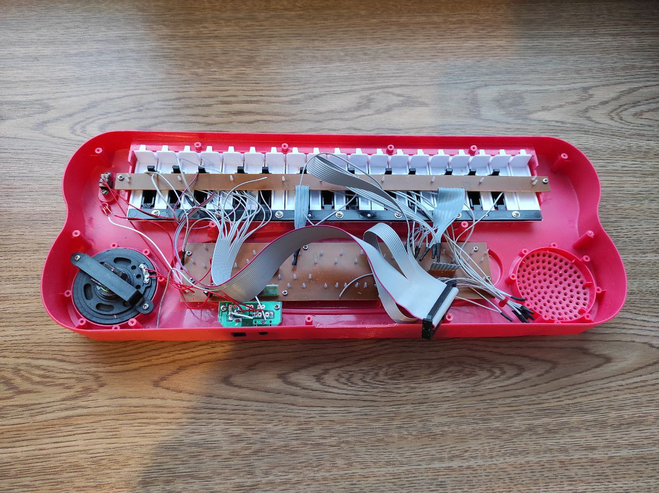
Soldering is finished
Put inside keyboard

Slide 11
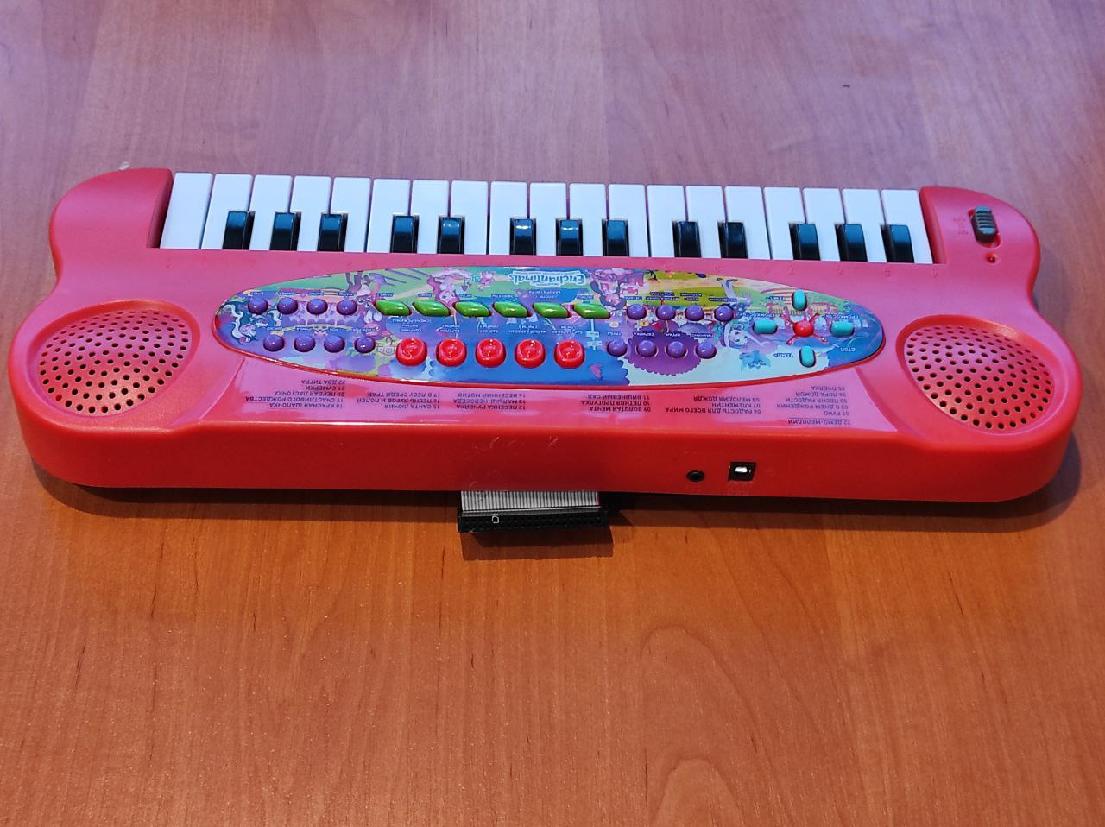
Keyboard is ready to be connected to Arduino!

Slide 12
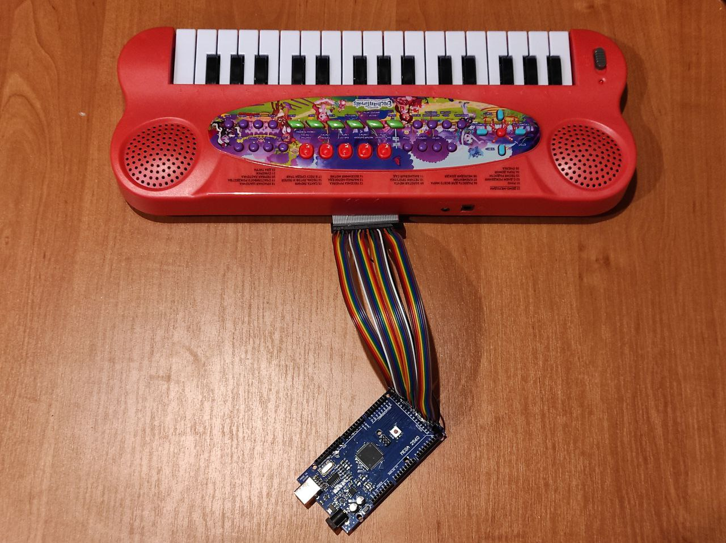
So, connect keyboard to Arduino and check it
Connect keyboard using 33 wires: 32 keys + Gnd.
This is the reason we use Arduino Mega, not Uno.
Download code and upload to Mega for testing keyboard:
https://github.com/EndlessBits/EndlessSynth/tree/main/keyboard_tests/keyboard_polyphony/01_SynthPinsTest_Polyphony

Slide 13
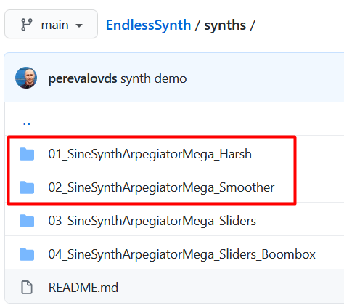
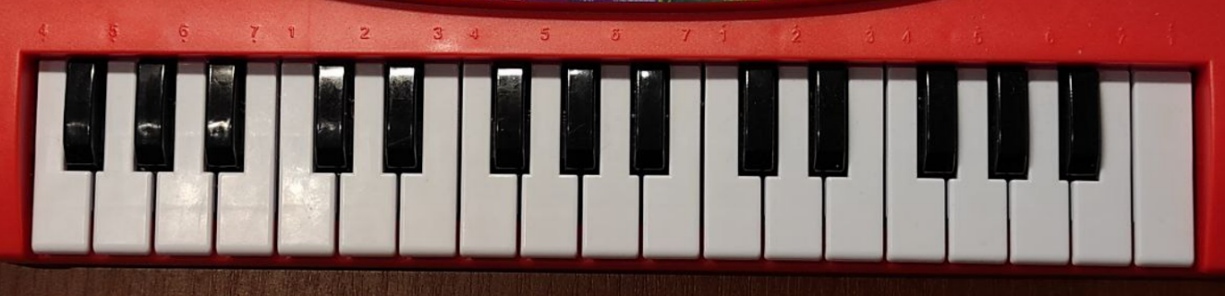
Next you may upload and play synthesizer!
It will use only keyboard and sound output:
https://github.com/EndlessBits/EndlessSynth/tree/main/synths
Two first projects – is that you need on this step.
Files contains detailed instructions how to connect
and play all – please read them carefully.
The main point there is that, well, synthesizer works as a guitar: to hear anythong, and must press 1,2 or 3 “notes” at the left part of keyboard, and hit “strings” – three right most keys.
Octave switch
Circles on image is an example what to press
to hear sound.
“notes”
“strings”

Slide 14
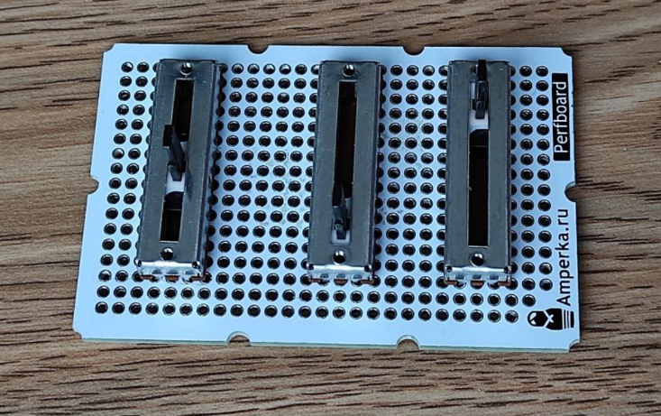
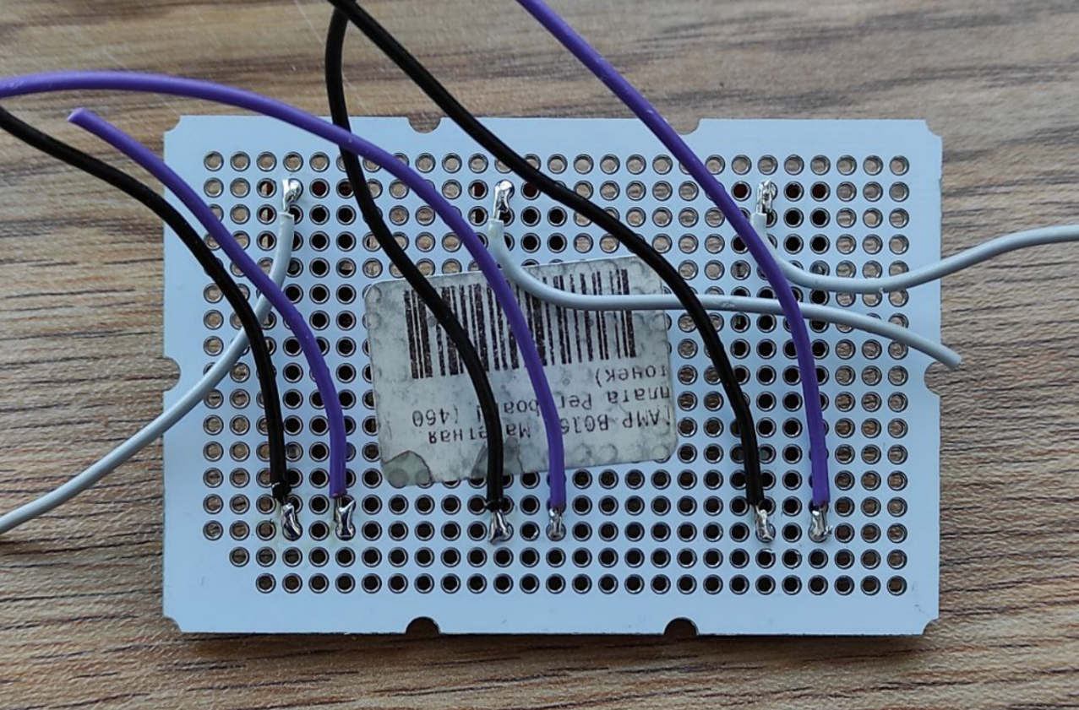
4. Sliders
You need: 1) Three 10 kOhm potentiometers.
2) Perforated bread board.
The first pot will be used to control output sound volume, the second and third will go to analog inputs of Arduino.
Steps:
Put pots to bread board
Solder wires
Put pots
Begin soldering wires

Slide 15
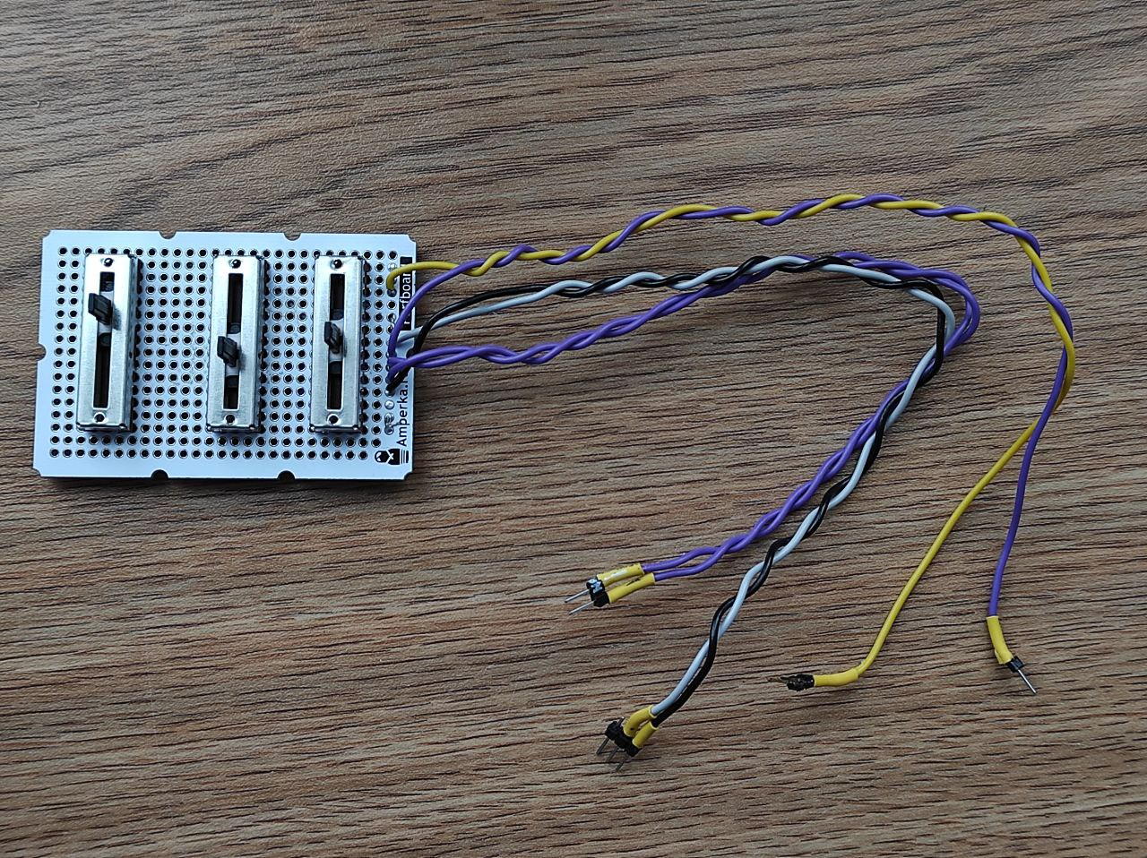
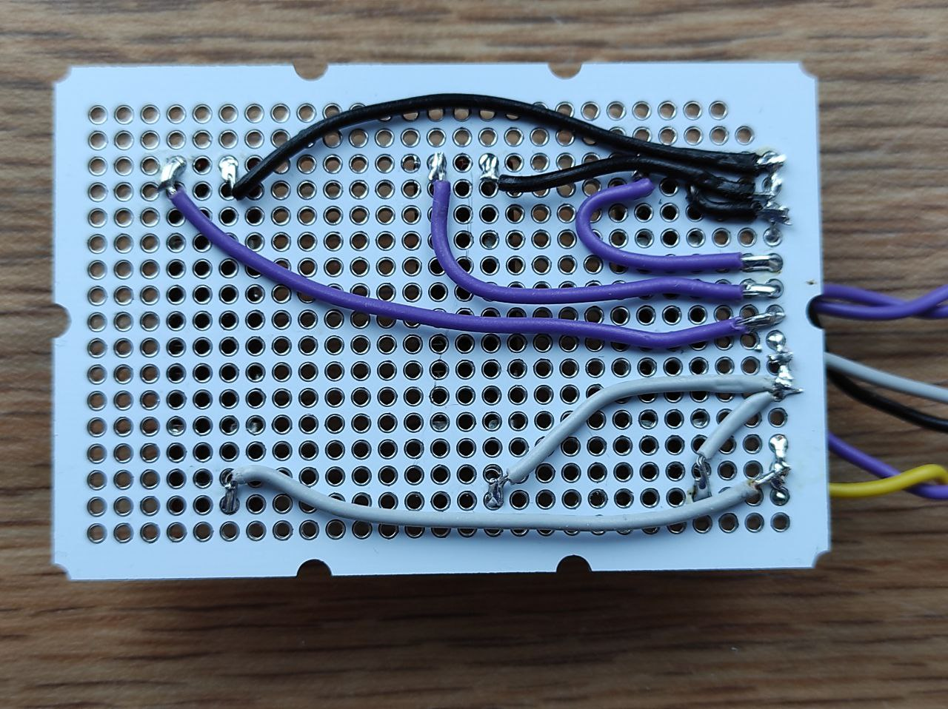
Black and white wires will be connected to Gnd and 5V
Two magenta wires will be connected to A4, A5.
Yellow and Magenta – connected to pin 2 (sound out) and to your sound output device input.

Slide 16
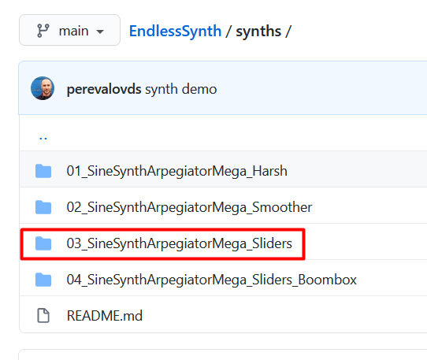
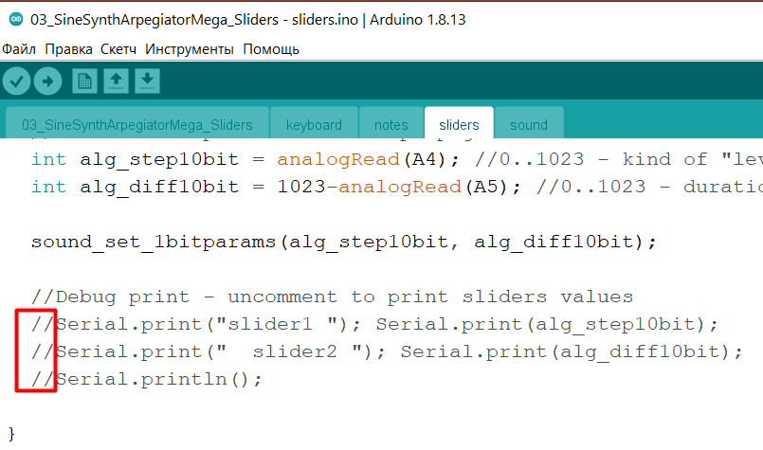
Test sliders!
Connect them as pointed at the previous page
Check that volume now regulated
3) Upload third synth. Now sound must change when you move sliders 2 and 3. To be sure that sliders connected properly, uncomment the following three lines in sliders file then sliders values will be printed to Arduino Serial Monitor:

Slide 17
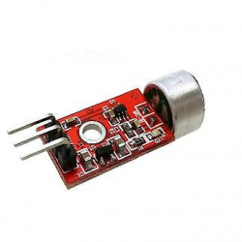
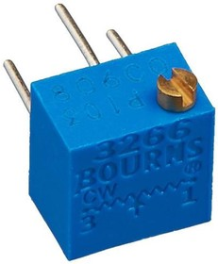
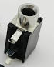
5. Mic module
You need:
“Standard” Arduino microphone module.
Trimmer resistor 10 kOhm.
Jack 3.5 socket adapter (mono or stereo, mono is preferable).
Perforated bread board.
Discussion:
Microphone unit gives -2.5V...2.5V output,
so to digitize signal carefully we need to pull up it to 0..5V range for A0.
As a solution, we connect trimmer resistor’s left and right pins to Gnd, 5V, and output to A0 too.
Next, we potentiometer to obtain 2.5V when Mic is in a silence (or, equally, 512 on A0).
Now microphone will output 0..5V to A0!
Microphone module FC 109
Trimmer resistor 3266P-1-103LF, 10 kOhm
Jack 3.5 socket adapter

Slide 18
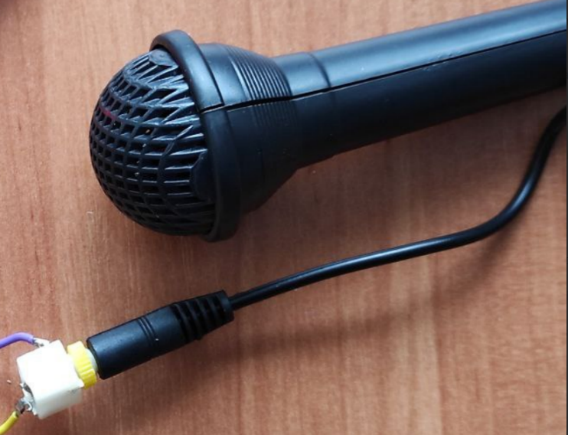
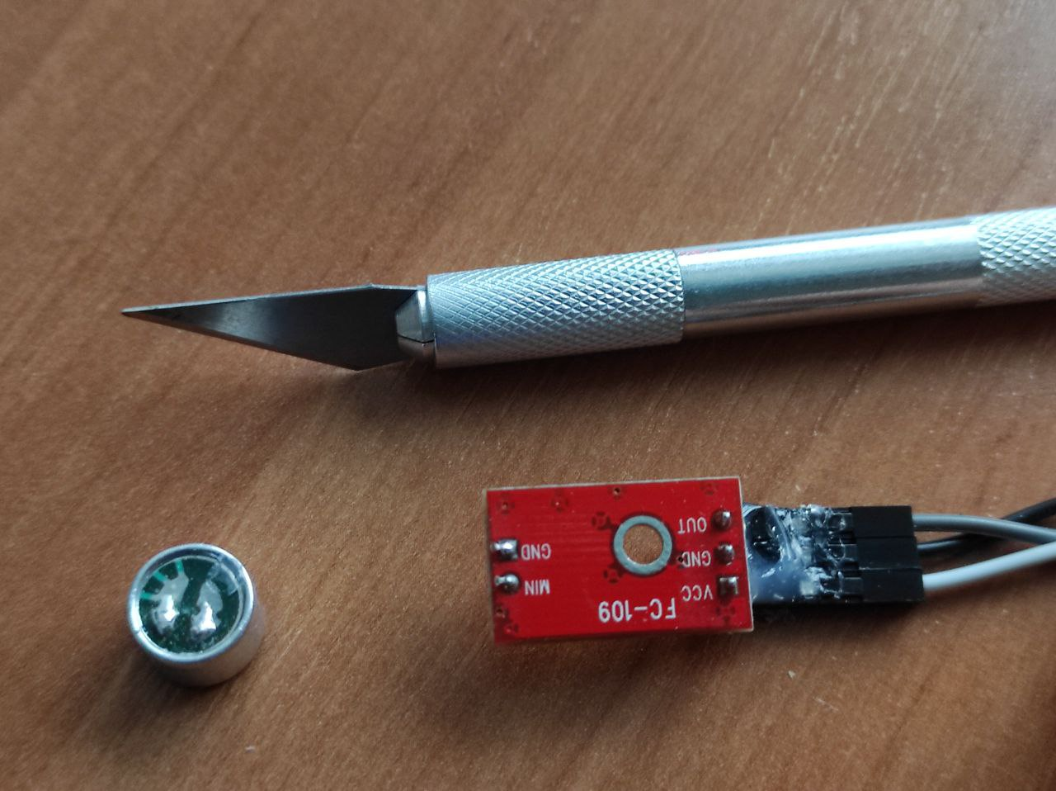
Steps:
Simple way: use this microphone. Connect mic module connect to Gnd, 5V, and output signal connect to A0, and connect trimmer resistor contact 1 to Gnd, contact 2 to A0 and contact 3 to 5V (so they connected in parallel).
Harder way: use toy microphone
Such microphones often goes together with toy synths, so may be you already have it. In this case,
Cut off microphone from module
Place module, trimmer resistor and Jack 3.5 socket adapter on bread board and solder connections (see the next page)
Toy microphone

Slide 19
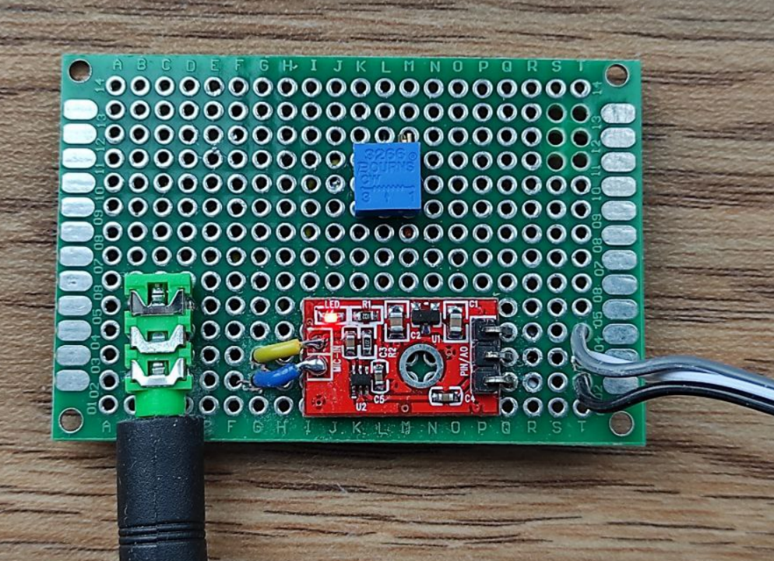
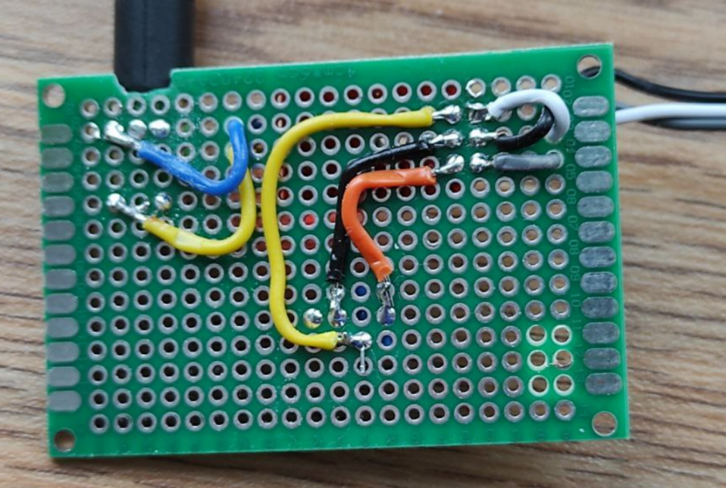
Place for connecting microphone
Wires connection: black to Gnd, Gray to 5V, White to A0.

Slide 20
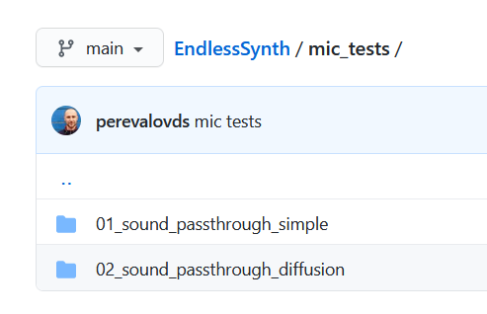
Having connected microphone module with microphone (toy or original) to Arduino, now adjust trimmer resistor.
To do it, upload to Arduino the following sketch:
https://github.com/EndlessBits/EndlessSynth/tree/main/mic_tests/01_sound_passthrough_simple
It gets input from A0 and converts it to 1-bit sound to pin 2 using simple comparison algorithm.
For us is important that it prints input values to Arduino Serial Monitor. So see on this values and adjust tune resistor using screwdriver so it outputs about 512 at silence.
The adjustment is ready.
Run 02_sound_passthrough_diffusion sketch for more advanced sound processing using dithering. Tell something to microhone! May be you need to do it louder to hear clear the result.

Slide 21
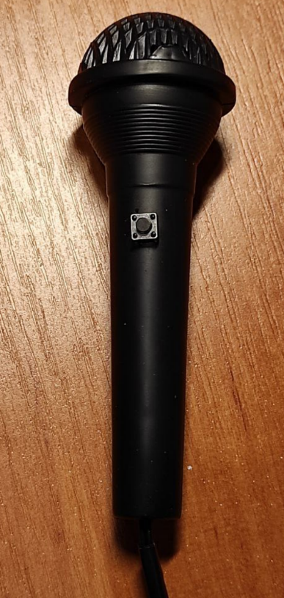
6. Mic with button
Now we can get sound from microphone. To use it in the synthesizer we need to add a button for switching
“boombox mode” on and off during performing on synth.
We describe how to add a button to microphone,
as depicted on the photo, but of course you may use any other button and not to place it to microphone.
You need:
Toy microphone
Compact button
Toy microphone with added button

Slide 22
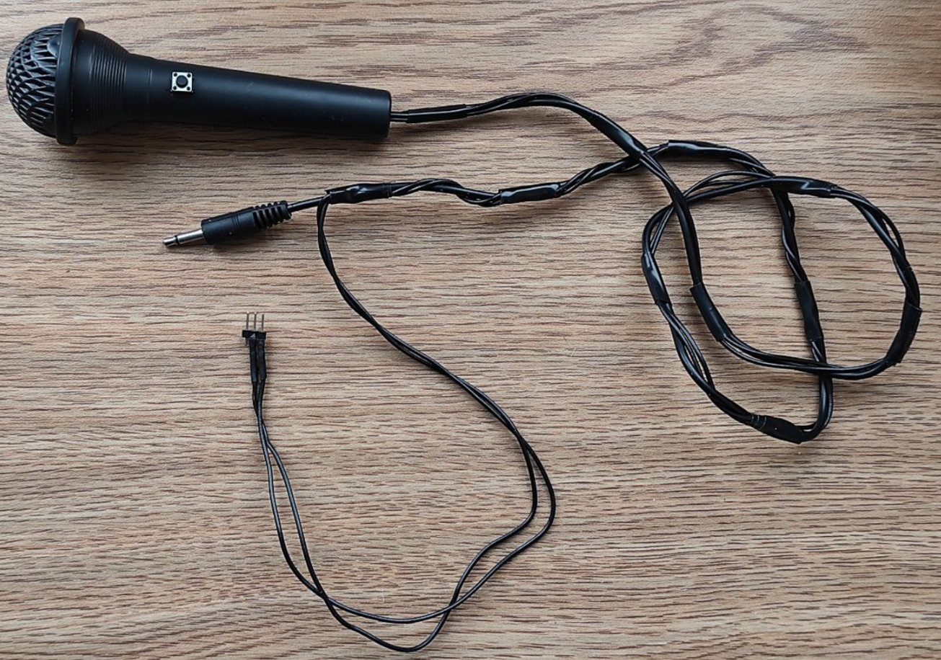
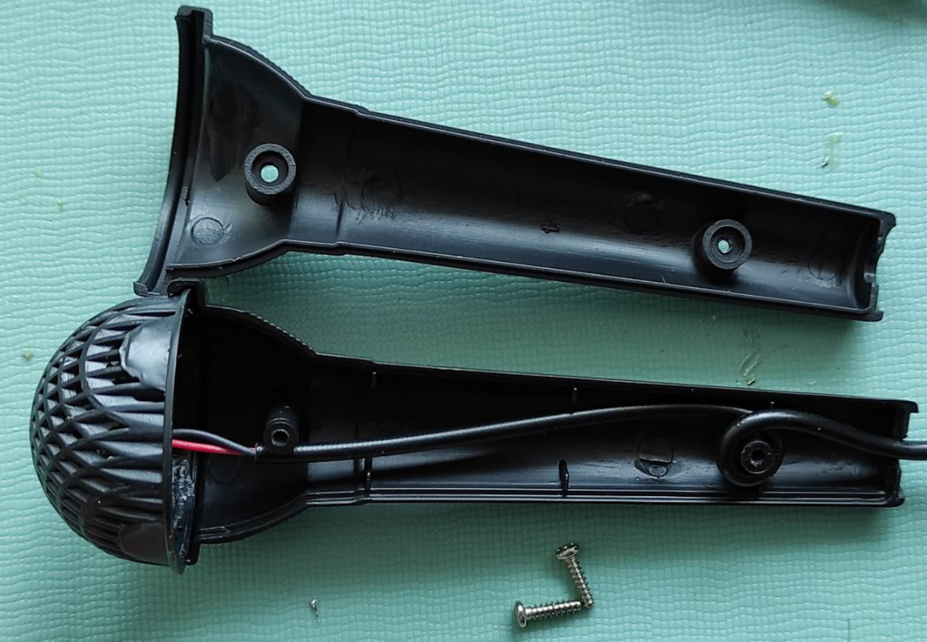
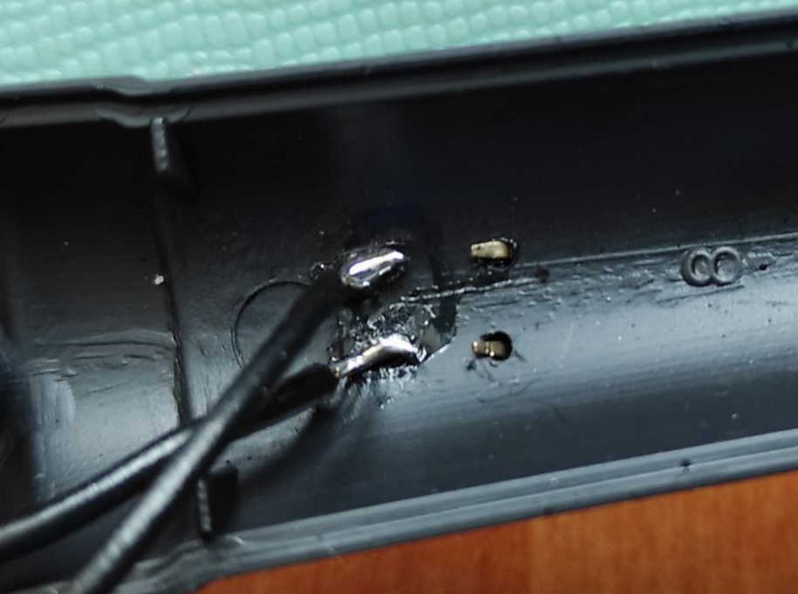
Steps:
Disassemble the mic
Make holes for button’s contacts
Put button and solder wires
Assembly mic
Solder male pin connectors
Disassembled mic
Button with soldered wires inside mic
Mic with button is ready to be connected to synth
Now connect button’s outputs to pins 8 and 9. If you made all the previous steps, the synth is ready!

Slide 23
7. Overall view
The synth is ready, so let’s see once again the synth’s part connections at a once.

Slide 24
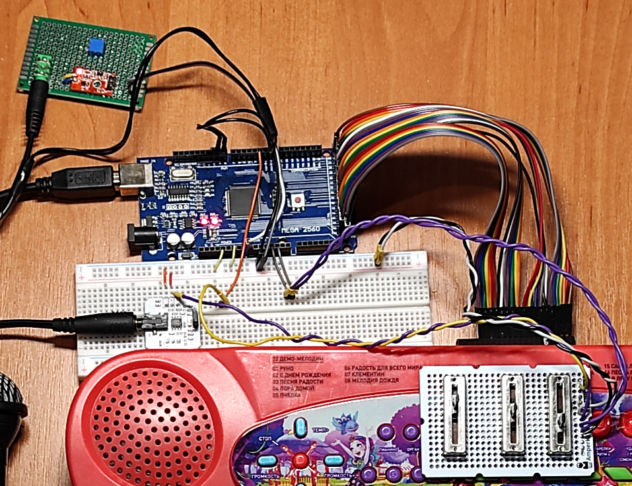

Slide 25
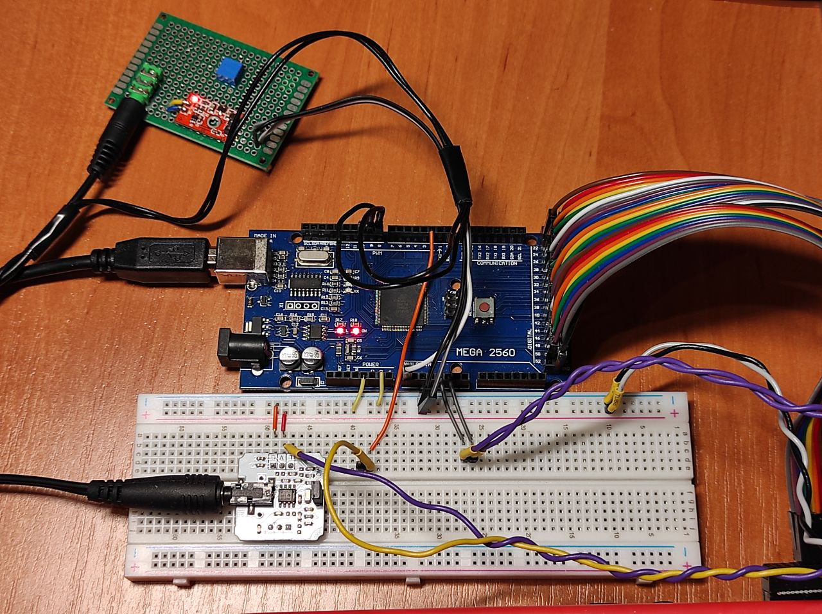

Slide 26
Synth hardware is completed. The final step:
Upload main synthesizer sketch to Arduino:
https://github.com/EndlessBits/EndlessSynth/tree/main/synths/04_SineSynthArpegiatorMega_Sliders_Boombox
Now start to play on keyboard and also press mic button to boomboxing!
Also, this sketch uses two more keys for switching audio sample rate – by default synth uses High, and Low makes sound “harsh”:
Octave switch
“notes”
“strings”
Lo and High audio sample rate switch
That’s all for now. Have fun!

Slide 27
Credits
We want to say thanks somebody: Thanks Alexey Shulgin for involving us to the worls of 1-bit projects.
Thanks our colleagues in Rodchenko school online for their ideas and critics.
Thanks Michael (https://irrlichtproject.de) for his help and fruitful discussions about 1-bit music programming.

